Slide 1
Module 6: Work with Dynamics 365 Sales Insights

Slide 2
Module agenda
Configure Dynamics 365 Sales Insights

Slide 3
Lesson 1: Configure Dynamics 365 Sales Insights

Slide 4
Sales Insights configuration overview
Free Sales Insights features - Includes basic Assistant cards, Auto capture, and Email engagement. These features are provided at no extra cost with Dynamics 365 Sales licensing.
Advanced Sales Insights features - Include Assistant (full capabilities) with studio, Notes analysis, Relationship analytics, Who knows whom, and predictive lead and opportunity scoring.
Sales Insights app - Uses analytics and data science to gather data from call recordings, Dynamics 365 Sales, and Microsoft 365 to provide information and insights to help you intelligently manage the sales team, proactively coach sellers, and quickly answer questions regarding the business.
Notes:
Do your sellers have good relationships with their customers? You might be surprised by customers' answers to that question. While you might perceive your relationships as good, your customers might see it differently. Many factors can influence a relationship with a customer such as when you reach out, the speed of your responses, and even the speed of their responses to you. Dynamics 365 Sales Insights uses AI to help you build and sustain good customer relationships.
Sales Insights includes three parts:
Free Sales Insights features - Includes basic Assistant cards, Auto capture, and Email engagement. These features are provided at no extra cost with Dynamics 365 Sales licensing.
Advanced Sales Insights features - Include Assistant (full capabilities) with studio, Notes analysis, Relationship analytics, Who knows whom, and predictive lead and opportunity scoring.
Sales Insights app - Uses analytics and data science to gather data from call recordings, Dynamics 365 Sales, and Microsoft 365 to provide information and insights to help you intelligently manage the sales team, proactively coach sellers, and quickly answer questions regarding the business.
Some Sales Insights features are available for free in the application while others will require an additional Sales Insights license so that you can use them in your organization. Depending on which features are available to them based on their licensing, administrators can enable and configure certain Sales Insights features as required by their organization.
To use the advanced features, you must purchase a Dynamics 365 Sales Insights license or start a trial. Regardless of whether you are using the free or the advanced features, you will still go to the same place in the application to configure. To configure the Sales Insights features, you might need to be a Dynamics 365 Sales Administrator.
Sales Insights uses integrations with several other applications for many of it features. For example, LinkedIn data can be used in Relationship analytics, if the solution is installed in Dynamics 365 and configured correctly.
Before you configure Sales Insights, we recommend that you set up and configure the following features:
Email - Ensure that an Exchange email server is configured and that mailbox records have been enabled for each user that will be taking advantage of features such as Auto capture, Email engagement, and Relationship analytics.
LinkedIn - If you want to use LinkedIn data for Relationship analytics, verify that the LinkedIn solution is installed in Dynamics 365 Sales and write-back from LinkedIn Sales navigator is enabled.
SharePoint & OneDrive for Business - To take advantage of the shared attachment options with Email engagement, you will need to enable SharePoint and OneDrive for Business Integration in your organization.
When you deploy Dynamics 365 Sales, the free insights features will be available in your organization. Some of the features might not be fully configured, but they will appear in the application. The advanced Sales Insights features will not be available by default. Enable these features by accepting the terms and conditions for your organization.
You can access all Sales Insights features from the Sales Hub app by changing the area to Sales Insights Settings. You will see an option to Try Sales Insights from the Get advanced AI capabilities with Sales Insights section. The installation takes several minutes to complete, and then the status appears in the status bar.
After the installation is complete, you are ready to configure the advanced Sales Insights features.
The Sales insights configuration screen is divided into four sections:
Assistant studio - Provides access to the new Assistant studio, where you can create new and edit existing cards, as well as controlling assistant card access and modifying optimization rankings.
Productivity intelligence - Provides quick access to productivity-related features in Sales Insights such as Auto capture, Email engagement, and Notes analysis.
Connection insights - Provides quick access to relationship and connection-related features in Sales Insights such as Relationship analytics, talking points, and Who knows whom.
Predictive models - Provides quick access to the predictive scoring features that are available in Sales Insights such as Lead scoring and Opportunity scoring.

Slide 5
Before you begin
Install and configure the following features:
Email - Ensure that an Exchange email server is configured and that mailbox records have been enabled for each user that will be taking advantage of features such as Auto capture, Email engagement, and Relationship analytics.
LinkedIn - If you want to use LinkedIn data for Relationship analytics, verify that the LinkedIn solution is installed in Dynamics 365 Sales and write-back from LinkedIn Sales navigator is enabled.
SharePoint & OneDrive for Business - To take advantage of the shared attachment options with Email engagement, you will need to enable SharePoint and OneDrive for Business Integration in your organization.

Slide 6
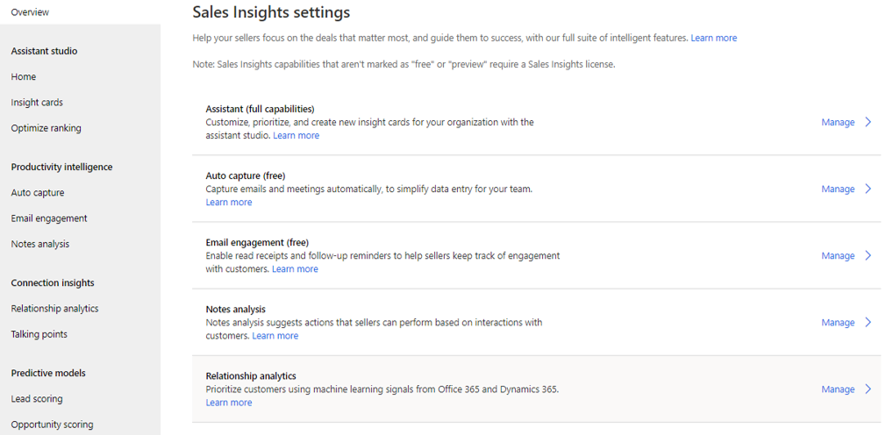
Enable advanced Sales Insights

Slide 7
Sales Insights configuration
User experience divided into four sections:
Assistant studio - Provides access to the new Assistant studio, where you can create new and edit existing cards, as well as controlling assistant card access and modifying optimization rankings.
Productivity intelligence - Provides quick access to productivity-related features in Sales Insights such as Auto capture, Email engagement, and Notes analysis.
Connection insights - Provides quick access to relationship and connection-related features in Sales Insights such as Relationship analytics, talking points, and Who knows whom.
Predictive models - Provides quick access to the predictive scoring features that are available in Sales Insights such as Lead scoring and Opportunity scoring.

Slide 8
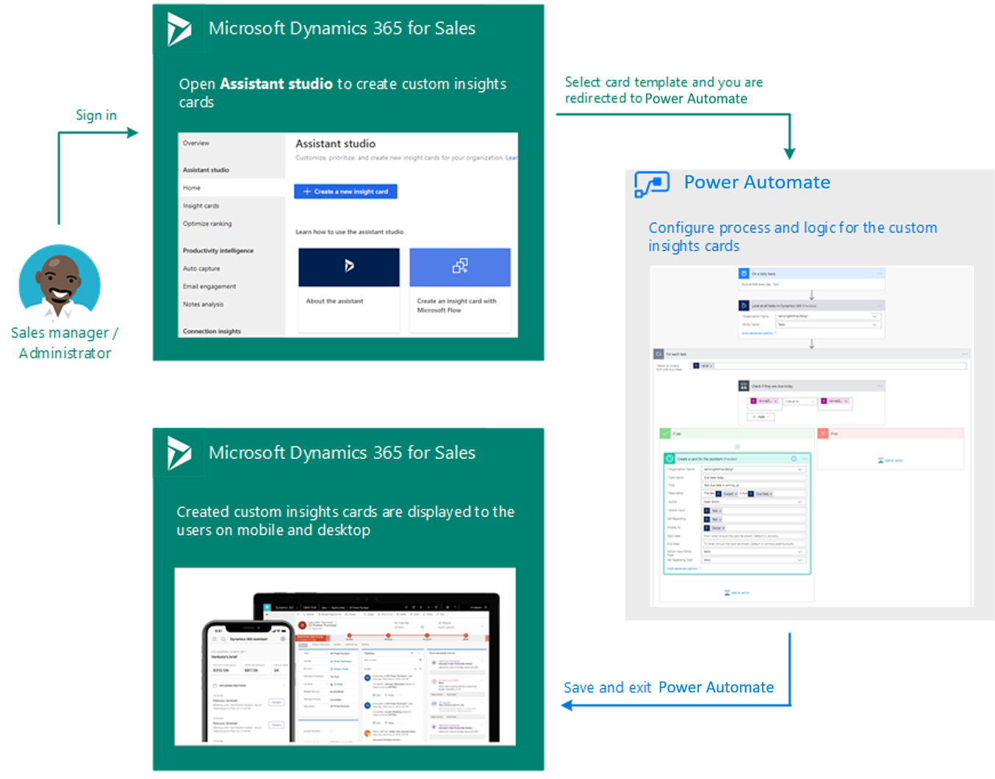
Create insight cards with Assistant studio
Provides actionable insight cards for users in Dynamics 365 Sales.

Slide 9
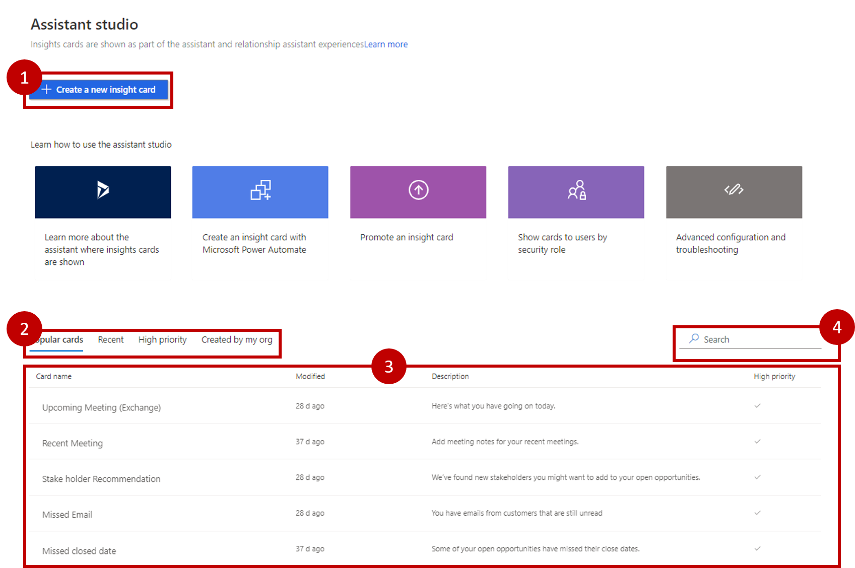
Assistant studio features
Create custom insight cards
Quick view cards through tabs
Table with card details
Search cards

Slide 10
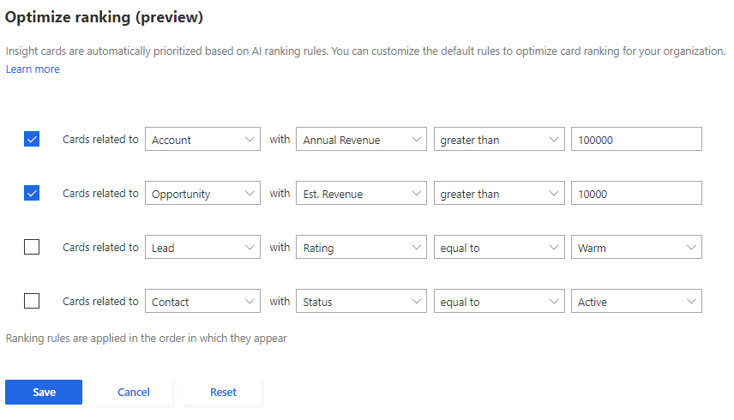
Optimize ranking of insight cards
When defining rules, you can use one of the four following properties when editing the rule:
Name of the entity
Attribute type
Condition
Value

Slide 11
Configure productivity intelligence
Email engagement - Tracks email communication between sellers and their customers.
Auto capture - Monitors email activities and suggests possible record associations-based factors (such as the sender) from the contents of the email.
Notes analysis - Provides suggestions to auto create activities based on the text that is entered in a note.

Slide 12
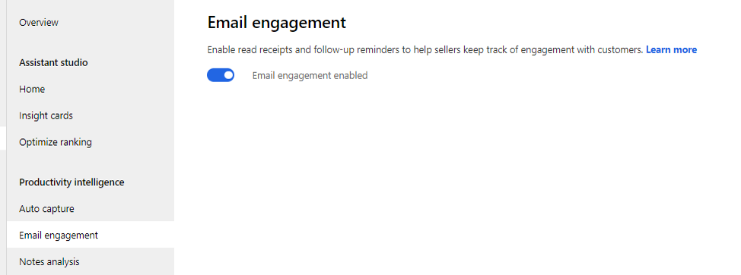
Configure Email engagement
Enable Email engagement from the Sales Insights settings area of the Sales Hub application.

Slide 13
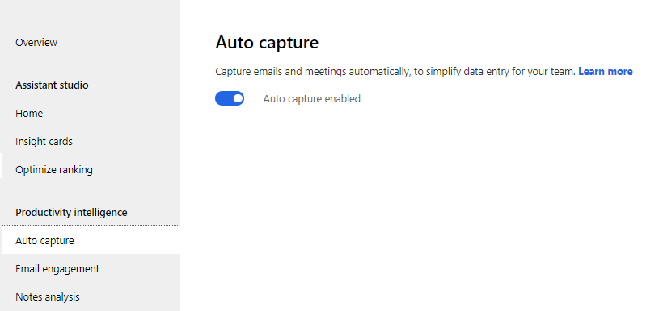
Enable Auto capture
After you accept the privacy statement for Sales Insights, Auto capture should be enabled by default. You can verify that it is enabled by going to the Sales Insights settings area and selecting Auto capture.

Slide 14
Configure connection insights
Relationship analytics - Monitors activities between you and your customers to provide an overall heath score. Actions can be triggered as the score changes so you can keep aware of the relationship.
Talking points - Identifies relevant subjects such as sports, entertainment, or family-related items from past customer communications and provides them as possible conversation starters.
Who knows whom - Identifies others inside your organization that might have an existing relationship with a lead or contact and provides you with the ability to request an introduction.

Slide 15
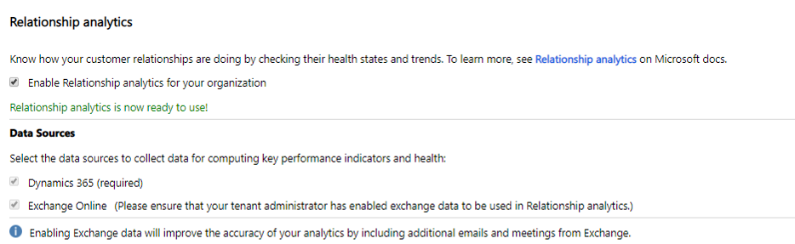
Configure relationship analytics
Provides a graphical representation of KPIs and activity history for any contact, opportunity, lead, or account to users of the application.

Slide 16
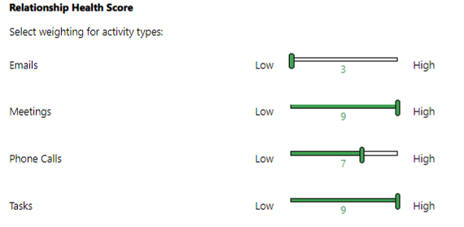
Relationship health score
Activity types:
Emails
Appointments
Phone calls
Overall (all activities)

Slide 17
Configure predictive models
The predictive lead and opportunity scoring capabilities of Dynamics 365 Sales Insights use machine learning models to calculate a score for all open leads and opportunities.
Grade A (green) - Highest likelihood for conversion.
Grade B (purple)
Grade C (yellow)
Grade D (red) - Lowest likelihood for conversion.

Slide 18
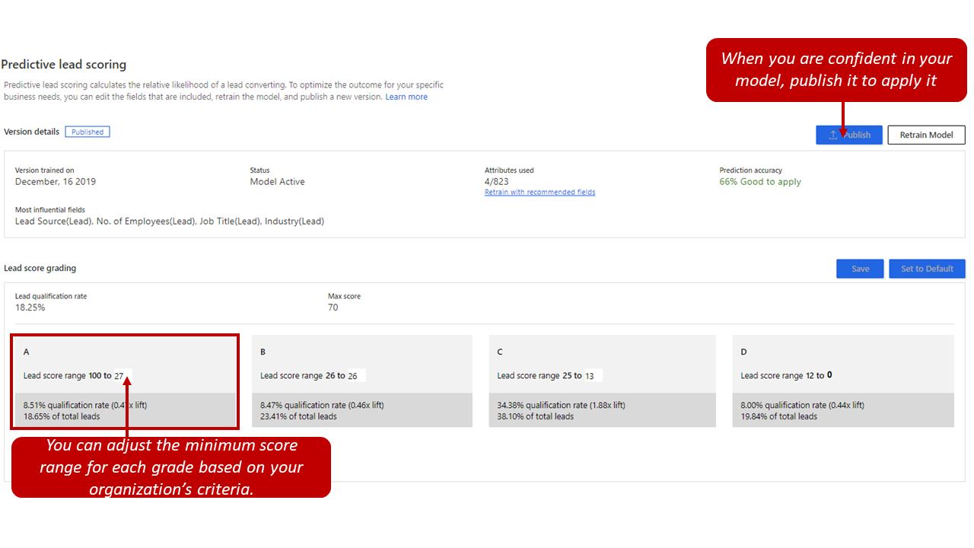
Predictive lead scoring

Slide 19
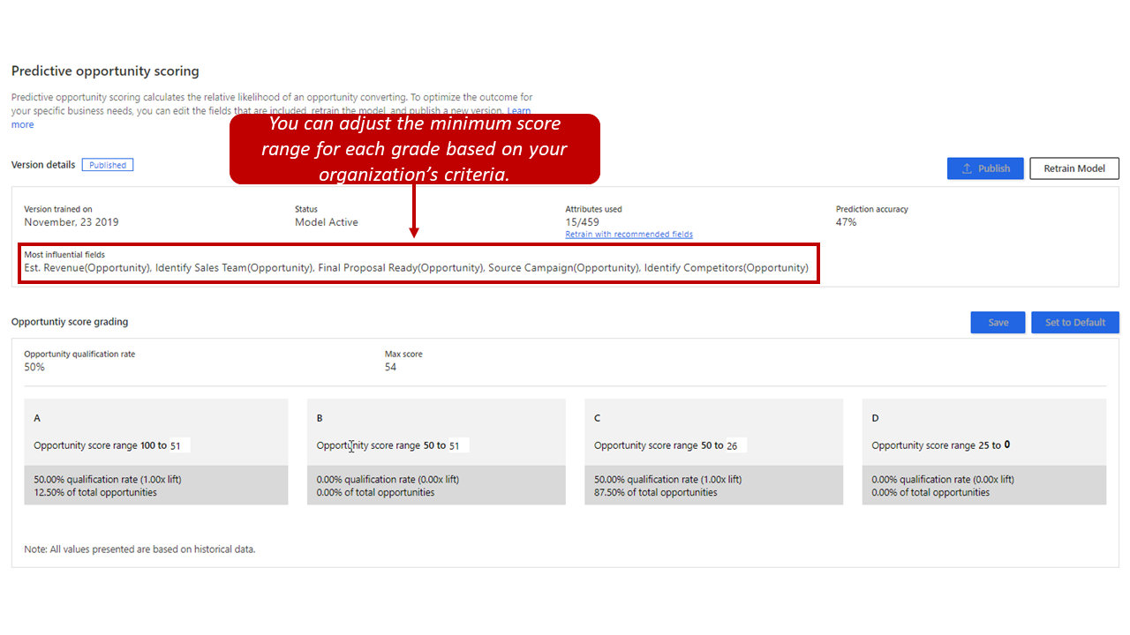
Predictive opportunity scoring

Slide 20
Demo 6.1: Sales Insights

Slide 21
Closing slide

